Slide 1




Development of master curricula for natural disasters risk management in Western Balkan countries
WP1.2 Established practices and study programs in Italy
Prof. Giuseppe Tito Aronica
University of Messina – Department of Engineering, ITALY
Workshop on master curricula best practices in EU partners/ 06th April 2017
Project number: 573806-EPP-1-2016-1-RS-EPPKA2-CBHE-JP
"This project has been funded with support from the European Commission. This publication reflects the views only of the author, and the Commission cannot be held responsible for any use which may be made of the information contained therein"

Slide 2
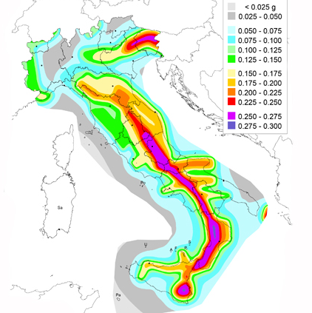
Introduction
Development of master curricula for natural disasters risk management in Western Balkan countries
Italy has a high exposure to natural risks: earthquakes, floods, landslides, volcanic eruptions, fires, avalanches and coastal erosion. Natural hazards, which add up to, those related to human activities, which contribute to making fragile the entire territory

Slide 3
Introduction
Development of master curricula for natural disasters risk management in Western Balkan countries
36% of the national territory is at high-medium seismic risk with some parts (south and Apennines showing a peak of 90%)
19% of the national territory is at high-medium landslide risk with some parts (Alps and Apennines showing a peak of 80%)
12% of the national territory is at high-medium flood risk with some parts (Po river basin with a peak of 45%)

Slide 4
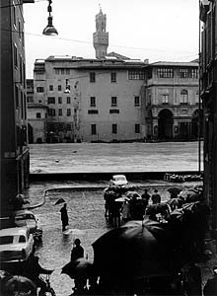
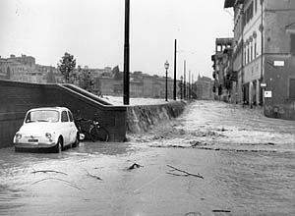
Floods
Development of master curricula for natural disasters risk management in Western Balkan countries
Florence, 4 November 1966

Slide 5
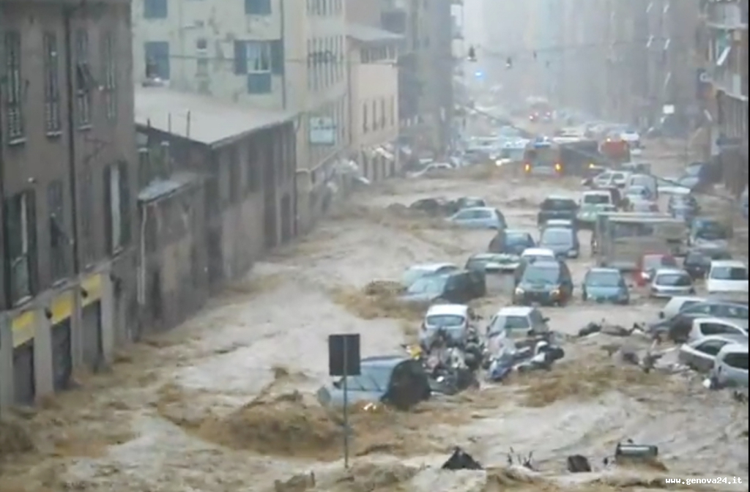
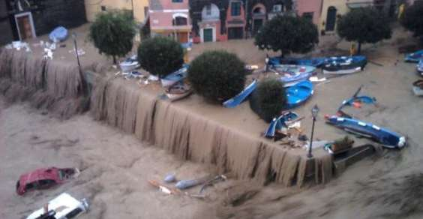
Floods
Development of master curricula for natural disasters risk management in Western Balkan countries
Genoa, 4 November 2011

Slide 6
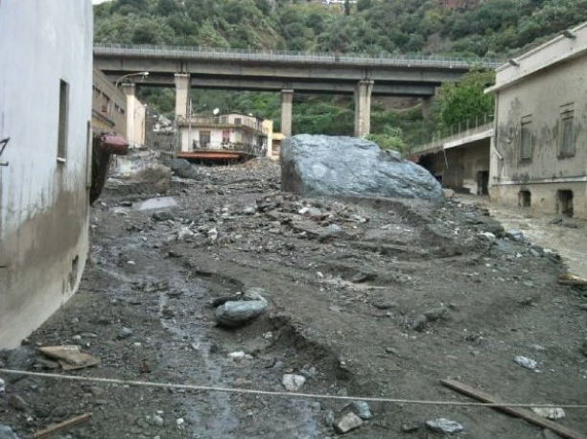
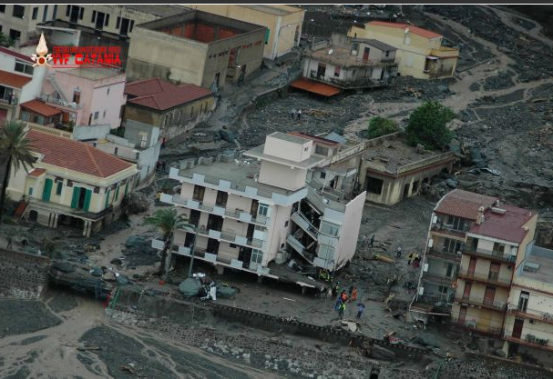
Floods
Development of master curricula for natural disasters risk management in Western Balkan countries
Messina, 1 October 2009

Slide 7
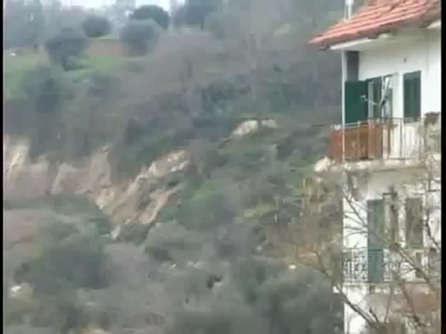
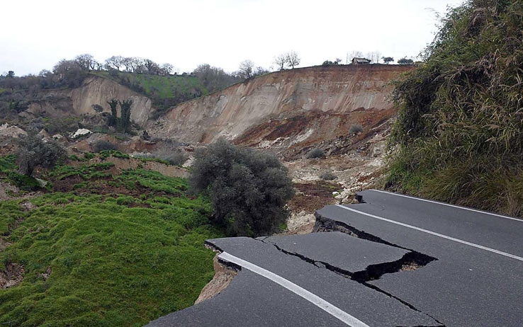
Landslides
Development of master curricula for natural disasters risk management in Western Balkan countries
Maierato, Calabria, 15 February 2010, no casualties

Slide 8
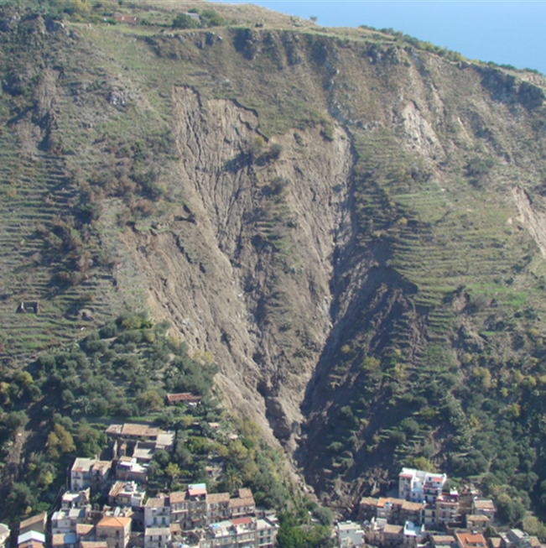
Landslides
Development of master curricula for natural disasters risk management in Western Balkan countries
Messina, Sicily, 1 October 2009, 39 casualties

Slide 9
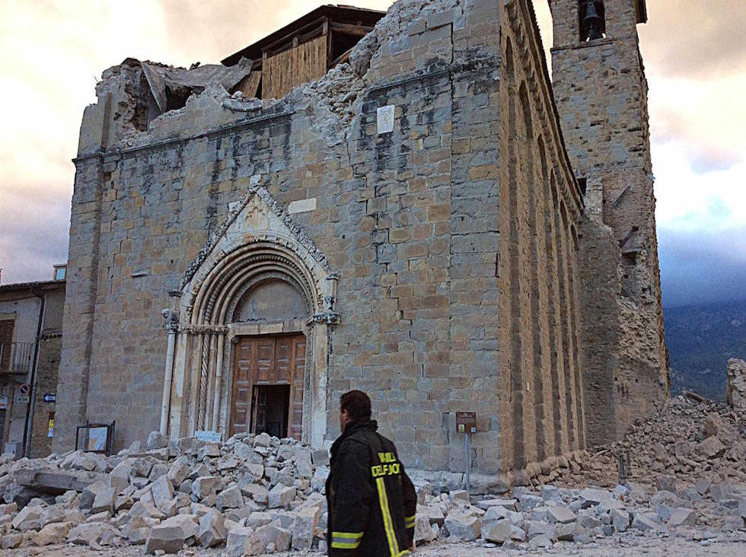
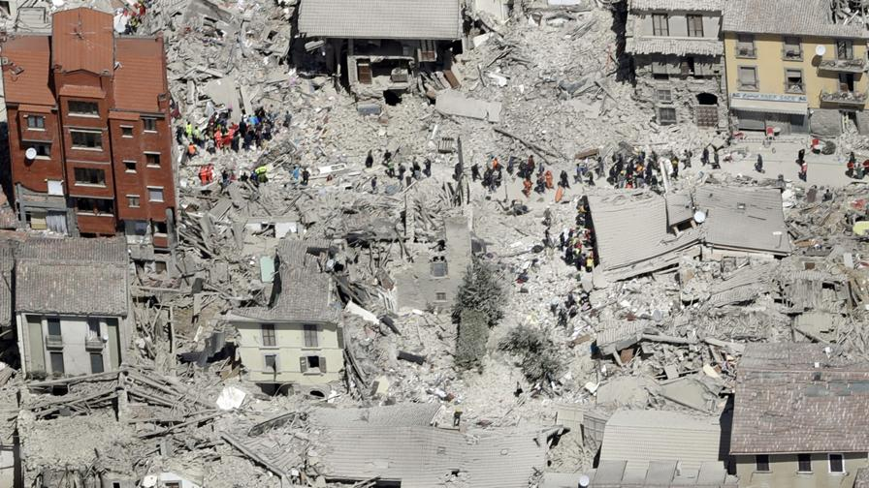
Earthquakes
Development of master curricula for natural disasters risk management in Western Balkan countries
Amatrice, Central Italy, 24 August 2016, 299 casualties
Magnitudo 6.2

Slide 10
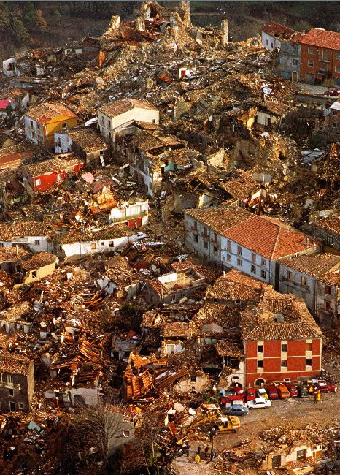
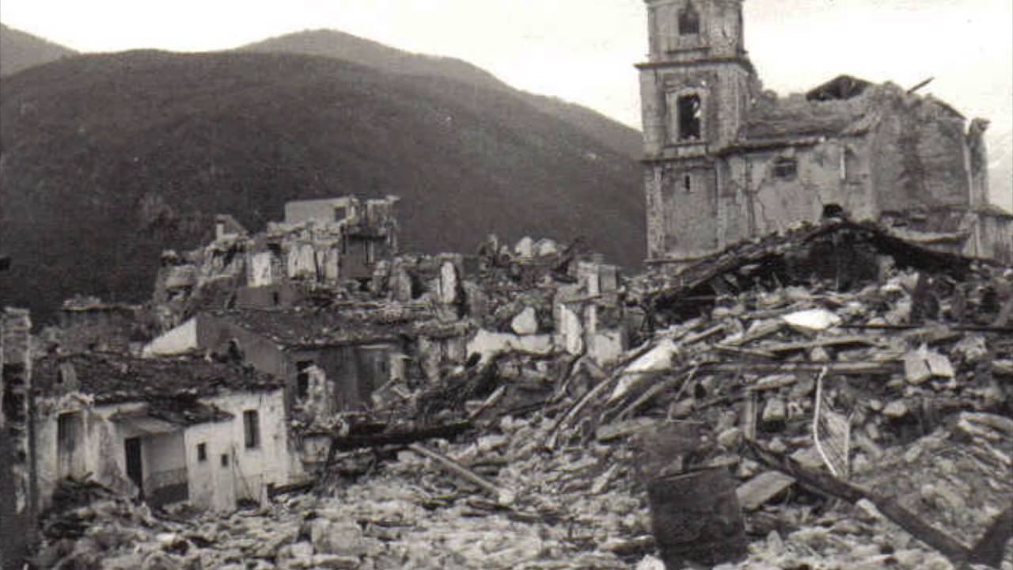
Earthquakes
Development of master curricula for natural disasters risk management in Western Balkan countries
Irpinia, South Italy, 23 November 1980, 2914 casualties
Magnitudo 6.9

Slide 11
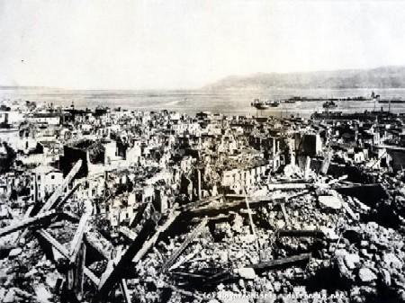
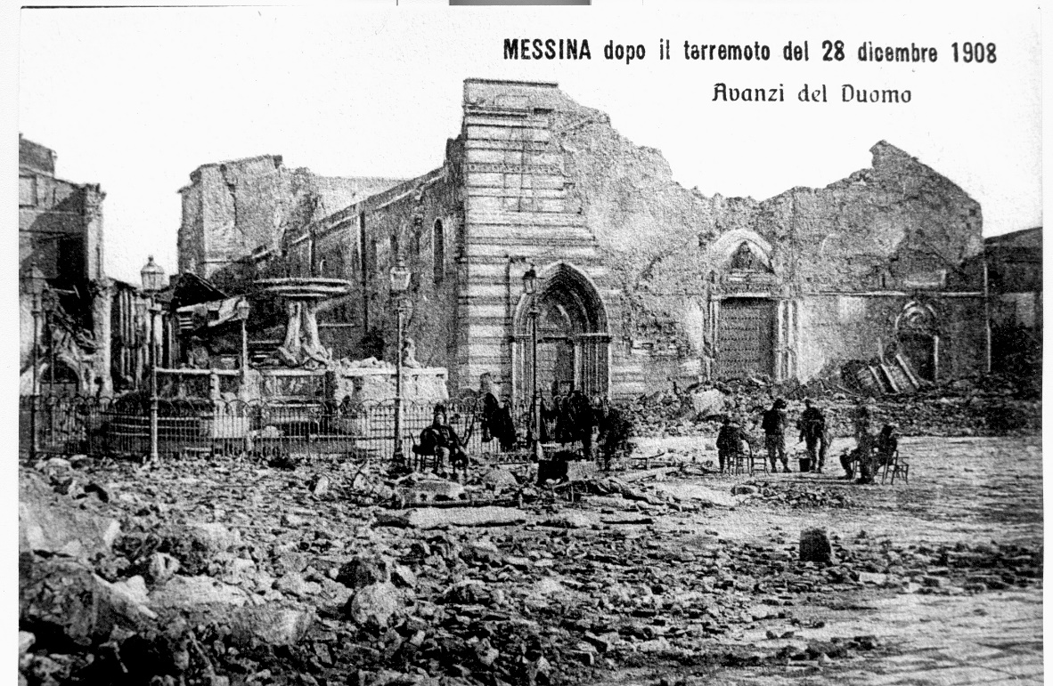
Earthquakes
Development of master curricula for natural disasters risk management in Western Balkan countries
Messina, Sicily, 28 December 1908, 80000 casualties
Magnitudo 7.2 + Tsunami

Slide 12
Established practices
Development of master curricula for natural disasters risk management in Western Balkan countries
In Italy, established practices to deal with natural risks can be classified under two main types:
Emergency
Civil Protection activities (monitoring, forecasting, post-event intervention, etc.
Non-emergency
Planning, Design, Policy implementation, etc.

Slide 13
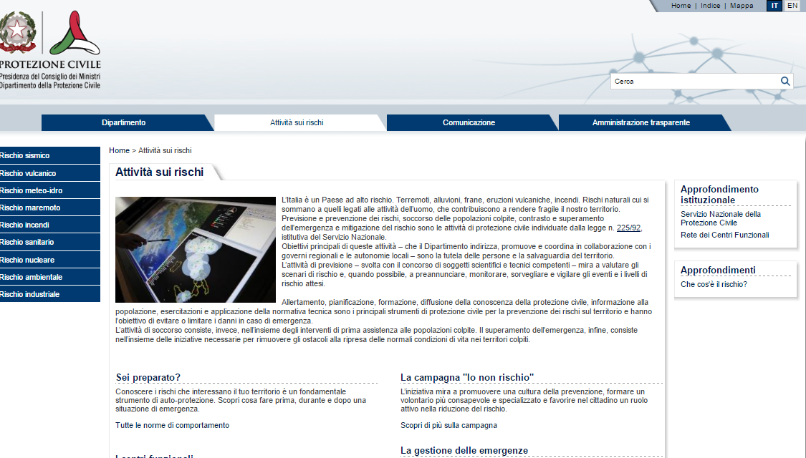
Civil Protection
Development of master curricula for natural disasters risk management in Western Balkan countries
The National Department of Civil Protection of Prime Minister Office, coordinates all civil protection measures in the country and informs citizens and civil authorities involved in this issue. (http://www.protezionecivile.gov.it/jcms/it/home.wp)

Slide 14
Civil Protection
Development of master curricula for natural disasters risk management in Western Balkan countries
contrast actions
aid organisation
damage assessment
Emergency management
event location
risk assessment
Forecasting & Surveillance
To identify needs, requirements and provide procedures & guide lines
risk mitigation through setting up the monitoring system
emergency plans drafting
Prevention

Slide 15
Civil Protection: Emergency
Development of master curricula for natural disasters risk management in Western Balkan countries
In situations of national emergency
In the event of natural calamities, catastrophes or other events which must be tackled with extraordinary means and powers, after the declaration of the state of emergency by the council of Ministers, the Prime Minister may avail of delegated commissioners and domestic operative structures for the necessary interventions. The management of the operative structures is assigned to the Head of the Civil Protection Department which chairs the Operative Committee

Slide 16
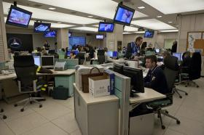
Civil Protection: Emergency
Development of master curricula for natural disasters risk management in Western Balkan countries
The Operative Committee
The Operative committee, which ensures coordination of the emergency activity is made up of representatives of the components and of the Operative Structures of the National Civil Protection Service and of Public and Private Bodies and Administrations which manage the emergency together.
• Voluntary service
• Fire Department
• Armed Forces
• Forestry commission
• Police Forces
• Italian red Cross
• National Health Service
• National technical services (Corps of Engineers)
Each Operative structure must ensure a correct and constant flow of information at a domestic level and at a territorial level, with the support of the Local Authorities (Municipal Level) and the Regional Operations Rooms.

Slide 17
Civil Protection: F&S
Development of master curricula for natural disasters risk management in Western Balkan countries
The Functional Centre for the Hydro-meteorological Risk (http://www.protezionecivile.gov.it/jcms/it/cfcri.wp) is the branch of the National Department of Civil Protection in charge for weather forecast and warning of extreme events as rainstorms, floods, landslides, etc.

Slide 18
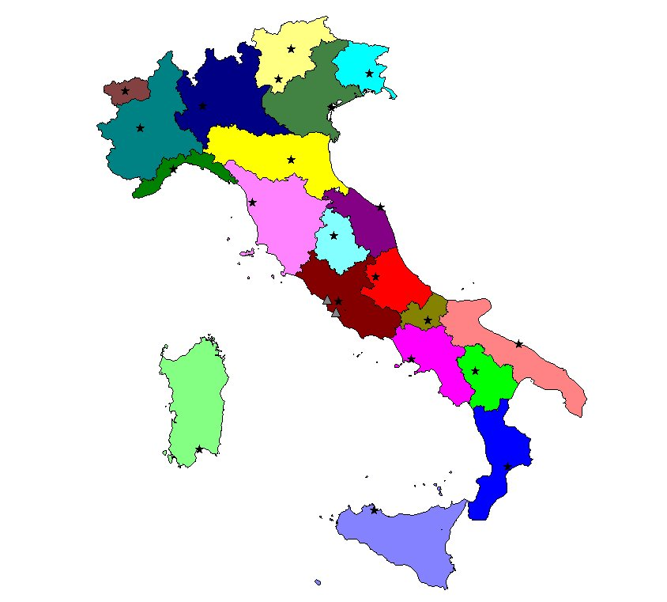
Civil Protection: F&S
Development of master curricula for natural disasters risk management in Western Balkan countries
“Functional Centres”
designed structures for the activities of technical support to the civil protection decision
21 regional centres planned
Almost 10 of those already fully operating
1 Primary Functional Centres
2 “Centres for Technological and Scientific services ”

Slide 19
Civil Protection: F&S
Development of master curricula for natural disasters risk management in Western Balkan countries

Slide 20
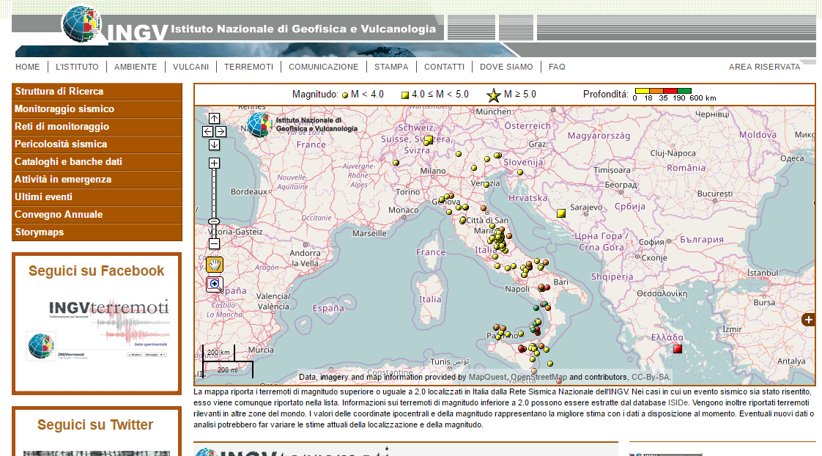
Civil Protection: F&S
Development of master curricula for natural disasters risk management in Western Balkan countries
Earthquake monitoring is officialy carried out by National Insititute for Geophysiscs and Vulcanology (INGV) which provide in real time (and after any event) all the information (as magnitude, localisation, etc) regarding any sesimic event occurred in Italy (http://terremoti.ingv.it/it/)

Slide 21
Established practices: Floods and landslides
Development of master curricula for natural disasters risk management in Western Balkan countries
In 1989, the first Law for the “soil protection” in Italy was enacted; the Law fixed the rules for the actions needed to guarantee the hydro-geomorphological land planning, suitable to the safety of the population, the protection of the cultural heritage, the environment and human activities.
Later, in 1998, in order to strengthen and enhance the previous Law, a new Act has been issued, defining the procedures to obtain a hydro-geomorphological land planning aimed at more clearly applying the concept of safeguarding and protection. The concept of risk was introduced, occurring as a result of the combination of the hazard, the value and the vulnerability of the elements at risk.
The above rules and principles have been implemented by the River Basins Hydrogeological Plans which provided the following results:
hazard and risk maps for floods and landslides, showing all scenarios;
provisions regarding land use in “high risk” and “high hazard” areas to prevent the increasing or generation of risk;
priority actions for risk reduction, identified according to the degree of risk;
On the basis of the Plans, the Map of the areas at high hydro-geomorphological critical state has been prepared to support the priority actions.

Slide 22
Development of master curricula for natural disasters risk management in Western Balkan countries
Established practices: Floods and landslides

Slide 23
Development of master curricula for natural disasters risk management in Western Balkan countries
Established practices: Floods and landslides

Slide 24
Established practices: Floods
Development of master curricula for natural disasters risk management in Western Balkan countries
The Flood Directive
Italy accepted the (Flood Directive) in 2010 with the Decree n.49. As the Floods Directive has entered into force the implementation of the Directive is starting.
Following Directive requirements, Italy have undertaken:
The preliminary flood risk assessment of the river basins and associated coastal zones, to identify areas where potential significant flood risk exists
The mapping of flood risk and hazard. The resulting maps identify areas with a medium likely hood of flooding (at least a 1 in 100 year event) and extreme events or low likelihood events, in which expected water depths should be indicated. In the areas identified as being at risk the number of inhabitants potentially at risk, the economic activity and the environmental damage potential shall be indicated
The redaction flood risk management plans for above areas

Slide 25
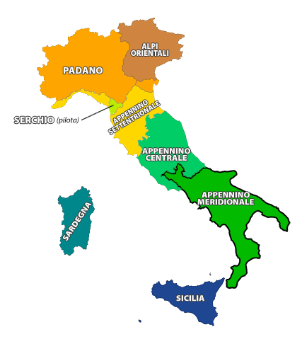
Established practices: Floods
Development of master curricula for natural disasters risk management in Western Balkan countries
The Flood Directive
Those activities have been implemented in the eitgh river basin districts in which the national territory was divided, out of which 2 are international sharing water courses with France to the west, Switzerland and Austria to the north and Slovenia to the east.
The Flood Risk Management Plans can be found on the pages of the respective competent authorities:
http://www.isprambiente.gov.it/pre_meteo/idro/Piani_gest.html.

Slide 26
Established practices: Earthquakes
Development of master curricula for natural disasters risk management in Western Balkan countries
National Plan for seismic risk prevention (art. 11, Abruzzo Decree Law)
After the Abruzzo earthquake of 6 April 2009 a new legal measure was issued in order to give a stronger push to seismic prevention. Article 11 of decree no. 39 of 28 April 2009 provides for the funding of seismic risk prevention works on the whole national territory and allocatetes 965 millions euros in 7 years. The Civil Protection Department manages the carrying out of art. 11, and orders of the President of Council of Ministers regulates it.
Intervention on schools and other sensitive buildings
Seismic checks on schools and interventions of structural and anti-seismic reconstruction to reduce the effects of the earthquakes: these actions see the commitment of the Department of Civil Protection - through the Regions - for safety in schools. The actions aim at seismic prevention started in 2002, right after the Puglia and Molise earthquake, that in San Giuliano di Puglia caused the collapse of the school "Francesco Jovine

Slide 27
Study programs
Development of master curricula for natural disasters risk management in Western Balkan countries
Master´s programme | Academic degree | University
Territorial Risk Management | MSc | University of Messina
Geoenvironmental resources and risks | MSc | University of Camerino
Civil Engineering for Risk Mitigation CERM | MSc | Polytechnic of Milan
Environmental risks and Civil Protection | MSc | Marche Polytechnic University
Engineering for natural risk management | MSc | University of Genoa
Engineering for natural and anthropic risks | MSc | University of Basilicata
Applied geology to engineering, land and risks | MSc | University of Rome “La Sapienza”

Slide 28
Study programs
Development of master curricula for natural disasters risk management in Western Balkan countries
Master´s programme | Academic degree | University
MEES – Master in Earthquake Engineering and Engineering Seismology | Postgraduate | School of Advanced Studies IUSS Pavia, University of Patras, University of Grenoble Alpes, Middle East Technical University
Master in Hydraulic Risk | Postgraduate | University of Cagliari, Interuniversity Consortium for Hydrology (CINID), Autonomous Region of Sardinia
HYDROMETHAZARDS - Master in Management of Hydrological and Meteorological Hazards | Postgraduate | University of Thessaly, Hellenic Open University, University of Messina, Universitat de Barcelona
LARAM – International School on LAndslide Risk Assessment and Mitigation | Postgraduate (only for PhD Students) | University of Salerno

Slide 29
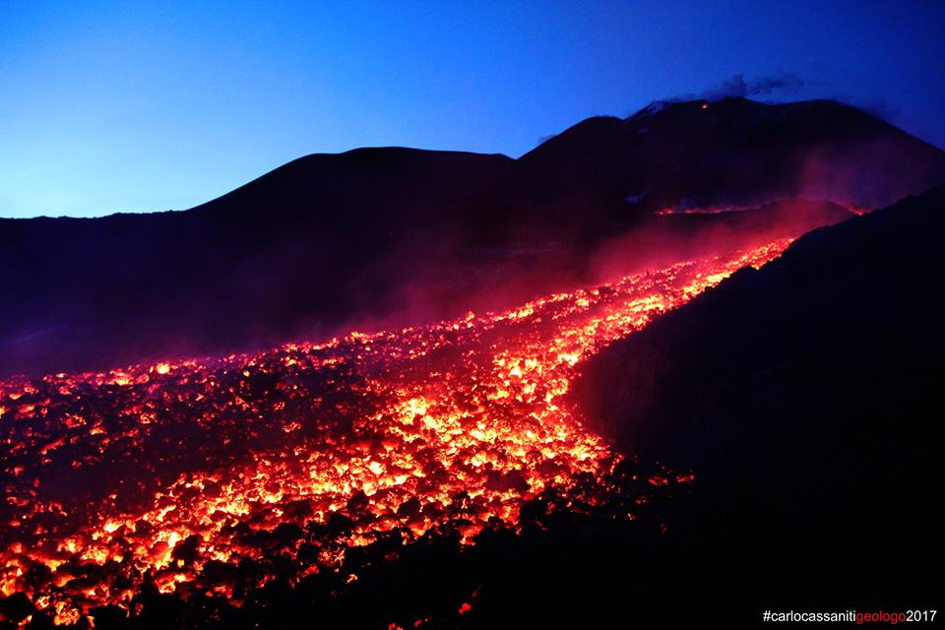
Thanks for your attention
Development of master curricula for natural disasters risk management in Western Balkan countries
02/04/2017

